Slide 1

OpenCV 4 and Python
Done
Part 1. Installation
Part 2. Basic image operations
Part 3 . Handling files and images

Slide 2
OpenCV 4 and Python
Part 4. Constructing Basic Shapes in OpenCV

Slide 3
Handling Files and Images
Image Files in OpenCV
A theoretical introduction to to drawing in OpenCV
Basic shapes—lines, rectangles, and circles
Basic shapes (2)—clip and arrowed lines, ellipses, and polylines
Drawing text
Dynamic drawing with mouse events
Advanced drawing

Slide 4
A theoretical introduction to drawing in OpenCV
OpenCV provides many functions to draw basic shapes. Common basic shapes include lines, rectangles, and circles. However, with OpenCV we can draw more basic shapes. As mentioned briefly in the introduction, it is a common approach to draw basic shapes on the image in order to do the following:
Show some intermediate results of your algorithm
Show the final results of your algorithm
Show some debugging information

Slide 5
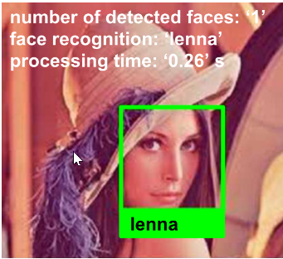
Display useful information on images
In the next screenshot, you can see an image modified to include some useful information in connection with the two algorithms mentioned in the introduction (face detection and face recognition). In this way, you can process all the images in a directory and, afterward, you can see where your algorithm has detected wrong faces (false positives) or even missing faces (false negatives):
false positive is an error where the result indicates the presence of a condition when in reality the condition is not satisfied (for example, a chair is classified as a face). A false negative is an error where the result indicates the absence of a condition when in reality the condition should be satisfied (for example, a face is not detected).

Slide 6
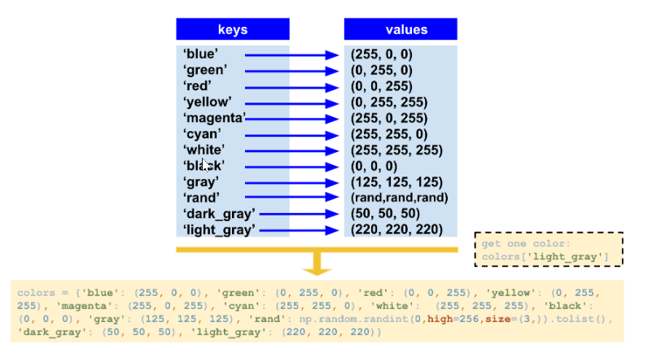
A colors dictionary

Slide 7
A constant colors file
A common approach is to create a constant.py file to define the colors. Each color is defined by a constant:
"""
Common colors triplets (BGR space) to use in OpenCV
"""
BLUE = (255, 0, 0)
GREEN = (0, 255, 0)
RED = (0, 0, 255)
YELLOW = (0, 255, 255)
MAGENTA = (255, 0, 255)
CYAN = (255, 255, 0)
DARK_GRAY = (50, 50, 50)
...

Slide 8
How to use these constants
The following code will enable you to use these constants:
import constant
# Getting red color:
print("red: '{}'".format(constant.RED))
Constants are usually specified in capital letters (for example, BLUE) and with underscores between the words (for example, DARK_GRAY).

Slide 9
Matplotlib function for ploting
Additionally, as we are going to plot the figures using Matplotlib, we have created a show_with_matplotlib() function with two arguments. The first one is the image we want to show, and the second is the title of the figure to plot. Therefore, the first step of this function converts the BGR image to RGB, because you have to show color images with Matplotlib. The second and final step of this function is to show the image using Matplotlib capabilities. To put these pieces together, the testing_colors.py script has been coded. In this script, we draw some lines, each one in a color of the dictionary.

Slide 10
The code to create the dictionary is shown here:
# Dictionary containing some colors
colors = {'blue': (255, 0, 0), 'green': (0, 255, 0), 'red': (0, 0, 255), 'yellow': (0, 255, 255), 'magenta': (255, 0, 255), 'cyan': (255, 255, 0), 'white': (255, 255, 255), 'black': (0, 0, 0), 'gray': (125, 125, 125), 'rand': np.random.randint(0, high=256, size=(3,)).tolist(), 'dark_gray': (50, 50, 50), 'light_gray': (220, 220, 220)}
You can see that some predefined colors are included in this dictionary—blue, green, red, yellow, magenta, cyan, white, black, gray, a random one, gray, dark_gray, and light_gray. If you want to use a specific color (for example, magenta), you should perform the following:
colors['magenta']

Slide 11
you do not need to memorize
Alternatively, you can use (255, 0, 255) to get the magenta color. But it is easier to use this dictionary rather than write triplets of numbers, because you do not need to memorize the addition properties of the RGB color space (adding blue—(255,0,0) and red—(0,0,255) gives magenta—(255, 0, 255) ). Remember that you can use constant.py to perform this functionality.

Slide 12
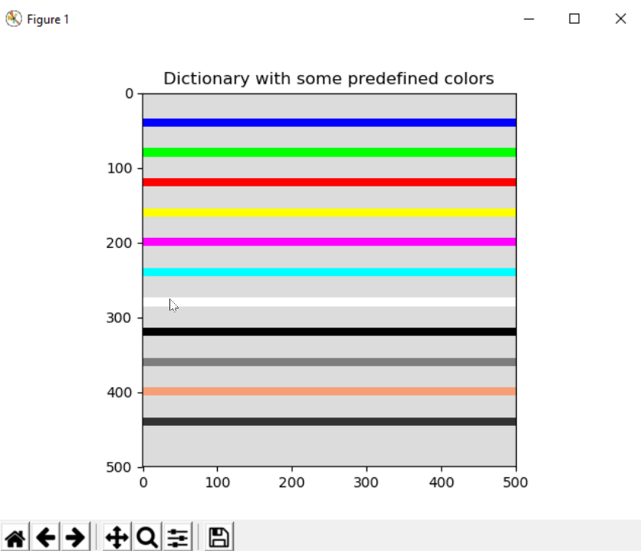
we have created the testing_colors.py script. If you execute it, you will see the next screens
In this example, we have created an image of size 500 500, with the 3 channels (we want a color image) and a uint8 type (8-bit unsigned integers). We have created it with a black background:

Slide 13
# We create the canvas to draw: 400 x 400 pixels, 3 channels, uint8 (8-bit unsigned integers)
# We set background to black using np.zeros()
image = np.zeros((500, 500, 3), dtype="uint8")
In this case, we want to set the background to light gray, not black. If you want to change the background, you can perform the following:
# If you want another background color, you can do the following:
image[:] = colors['light_gray']

Slide 14
Next, we add the functionality of drawing some lines, each one in a color of the dictionary. It should be noted that in the next section we are going to see how to create some basic shapes, so do not worry if you don't understand the code to create the lines:
# We draw all the colors to test the dictionary
# We draw some lines, each one in a color. To get the color, use 'colors[key]'
separation = 40
for key in colors:
cv2.line(image, (0, separation), (500, separation), colors[key], 10)
separation += 40
And finally, we draw the image using the created show_with_matplotlib() function:
# Show image:
show_with_matplotlib(image, 'Dictionary with some predefined colors')
The two arguments of show_with_matplotlib() are the image to plot and the title to show. So now we are ready to start creating some basic shapes with OpenCV and Python.

Slide 15
Drawing shapes
In this section, we are going to see how to draw shapes using OpenCV capabilities. Firstly, we will look at how to draw the basic shapes, and then we will focus on more advanced shapes.

Slide 16
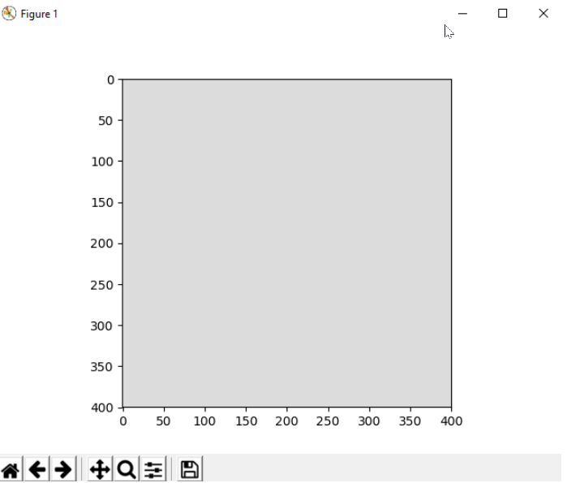
Basic shapes – lines, rectangles, and circles
In the next example, we are going to see how to draw basic shapes in OpenCV. These basic shapes include lines, rectangles, and circles, which are the most common and simple shapes to draw. The first step is to create an image where the shapes will be drawn. To this end, a 400 400 image with the 3 channels (to properly display a BGR image) and a uint8 type (8-bit unsigned integers) will be created:
# We create the canvas to draw: 400 x 400 pixels, 3 channels, uint8 (8-bit unsigned integers)
# We set the background to black using np.zeros()
image = np.zeros((400, 400, 3), dtype="uint8")
We set the background to light gray using the colors dictionary:
# If you want another background color, you can do the following:
image[:] = colors['light_gray']

Slide 17
most drawing functions
Now, we are ready to draw the basic shapes. It should be noted that most drawing functions that OpenCV provides have common parameters. For the sake of simplicity, these parameters are briefly introduced here:
img: It is the image where the shape will be drawn.
color: It is the color (BGR triplet) used to draw the shape.
thickness: If this value is positive, it is the thickness of the shape outline. Otherwise, a filled shape will be drawn.
lineType: It is the type of the shape boundary. OpenCV provides three types of line:
cv2.LINE_4: This means four-connected lines
cv2.LINE_8: This means eight-connected lines
cv2.LINE_AA: This means an anti-aliased line
shift: This indicates the number of fractional bits in connection with the coordinates of some points defining the shape.

Slide 18
In connection with the aforementioned parameters, the cv2.LINE_AA option for lineType produces a much better quality drawing (for example, when drawing text), but it is slower to draw. So, this consideration should be taken into account. Both the eight-connected and the four-connected lines, which are non-antialiased lines, are drawn with the Bresenham algorithm. For the anti-aliased line type, the Gaussian filtering algorithm is used. Additionally, the shift parameter is necessary because many drawing functions can't deal with sub-pixel accuracy. For simplicity in our examples, we are going to work with integer coordinates. Therefore, this value will be set to 0 (shift = 0). However to give you a complete understanding, an example of how to use the shift parameter will also be provided.
Remember that, for all the examples included in this section, a canvas has been created to draw all the shapes. This canvas is a 400 x 400 pixel image, with a light gray background. See the previous screenshot, which shows this canvas.

Slide 19
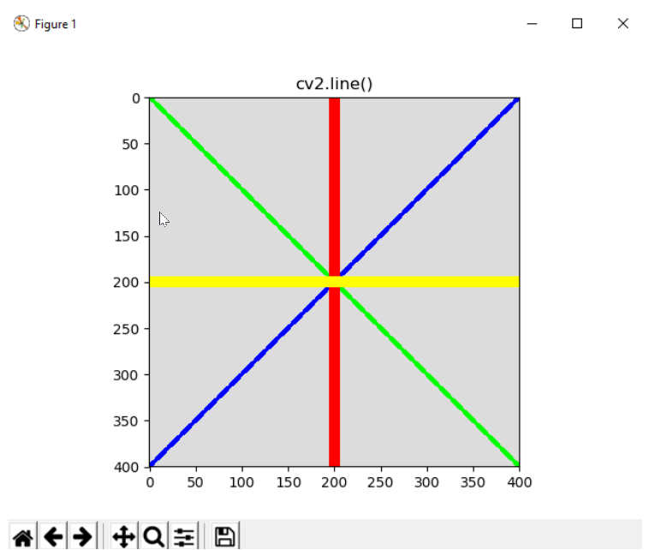
Drawing lines
The first function we are going to see is cv2.line(). The signature is as follows:
img = line(img, pt1, pt2, color, thickness=1, lineType=8, shift=0)
This function draws a line on the img image connecting pt1 and pt2:
cv2.line(image, (0, 0), (400, 400), colors['green'], 3)
cv2.line(image, (0, 400), (400, 0), colors['blue'], 10)
cv2.line(image, (200, 0), (200, 400), colors['red'], 3)
cv2.line(image, (0, 200), (400, 200), colors['yellow'], 10)
After coding these lines, we call the show_with_matplotlib(image, 'cv2.line()') function. The result is shown in the next screenshot:

Slide 20
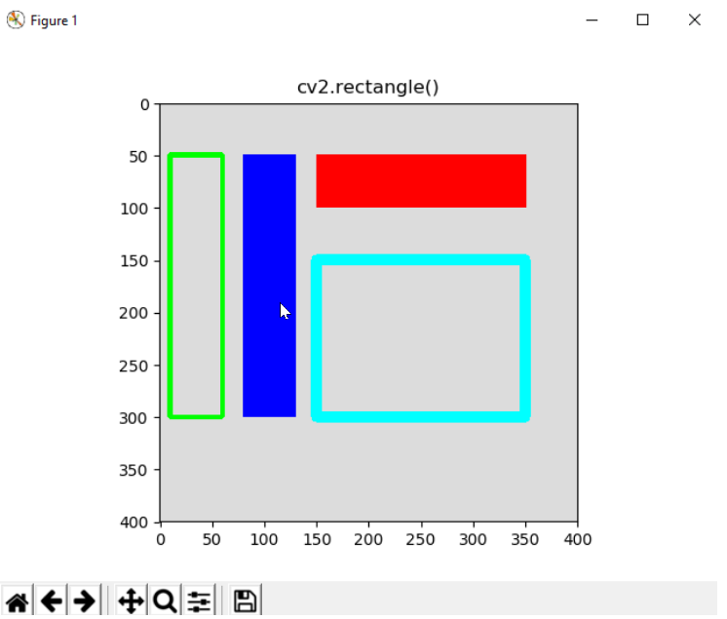
Drawing rectangles
The signature for the cv2.rectangle() function is as follows:
img = rectangle(img, pt1, pt2, color, thickness=1, lineType=8, shift=0)
This function draws a rectangle given the two opposite corners, pt1 and pt2:
cv2.rectangle(image, (10, 50), (60, 300), colors['green'], 3)
cv2.rectangle(image, (80, 50), (130, 300), colors['blue'], -1)
cv2.rectangle(image, (150, 50), (350, 100), colors['red'], -1)
cv2.rectangle(image, (150, 150), (350, 300), colors['cyan'], 10)
After drawing these rectangles, we call the show_with_matplotlib(image, 'cv2.rectangle()')function. The result is shown in the next screenshot:
Remember that negative values (for example, -1) for the thickness parameter mean that a filled shape will be drawn.

Slide 21
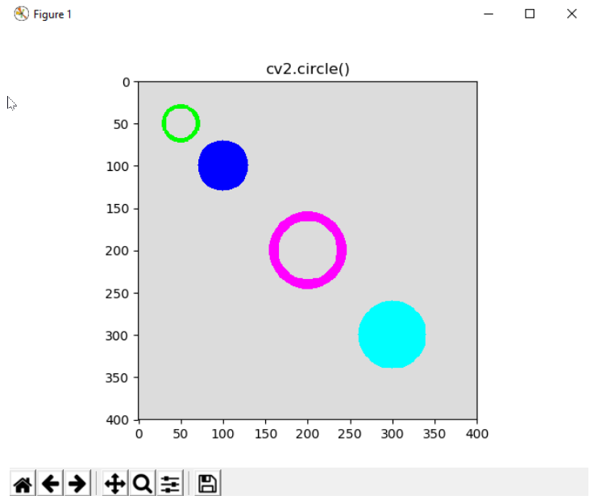
Drawing circles
The signature for the cv2.circle() function is as follows:
img = circle(img, center, radius, color, thickness=1, lineType=8, shift=0)
This function draws a circle with a radius radius centered in the center position. Some circles are defined in the following code:
cv2.circle(image, (50, 50), 20, colors['green'], 3)
cv2.circle(image, (100, 100), 30, colors['blue'], -1)
cv2.circle(image, (200, 200), 40, colors['magenta'], 10)
cv2.circle(image, (300, 300), 40, colors['cyan'], -1)
After drawing these circles, we call the show_with_matplotlib(image, 'cv2.circle()')function. The result is shown
he full code of the examples of this section can be seen in basic_drawing.py. in the next screenshot:

Slide 22
Understanding advanced shapes
In this section, we are going to see how to draw clip lines, arrowed lines, ellipses, and polylines. These shapes are not as straightforward to draw as the shapes we saw in the previous section, but they are simple to understand. The first step is to create an image where the shapes will be drawn. For this, a 300 300 image with the 3 channels (to properly display a BGR image) and a uint8 type (8-bit unsigned integers) will be created:
# We create the canvas to draw: 300 x 300 pixels, 3 channels, uint8 (8-bit unsigned integers)
# We set the background to black using np.zeros()
image = np.zeros((300, 300, 3), dtype="uint8")
We set the background to light gray using the colors dictionary:
# If you want another background color, you can do the following:
image[:] = colors['light_gray']
At this point, we can start drawing the new shapes.

Slide 23
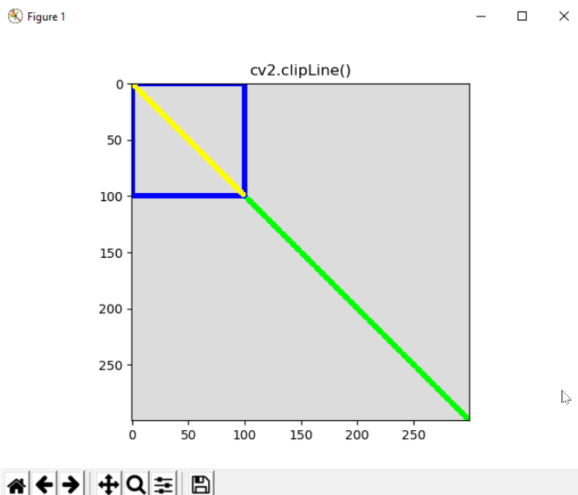
Drawing a clip line
The signature for the cv2.clipLine() function is as follows as follows:
retval, pt1, pt2 = clipLine(imgRect, pt1, pt2)
The cv2.clipLine() function returns the segment (defined by the pt1 and pt2 output points) inside the rectangle (the function clips the segment against the defined rectangle). In this sense, retval is False, if the two original pt1 and pt2 points are both outside the rectangle. Otherwise (some of the two pt1 or pt2 points are inside the rectangle) this function returns True. This can be more clearly seen with the next piece of code:
cv2.line(image, (0, 0), (300, 300), colors['green'], 3)
cv2.rectangle(image, (0, 0), (100, 100), colors['blue'], 3)
ret, p1, p2 = cv2.clipLine((0, 0, 100, 100), (0, 0), (300, 300))
if ret:
cv2.line(image, p1, p2, colors['yellow'], 3)
In the next screenshot, you can see the resultant figure after executing this piece of code:

Slide 24
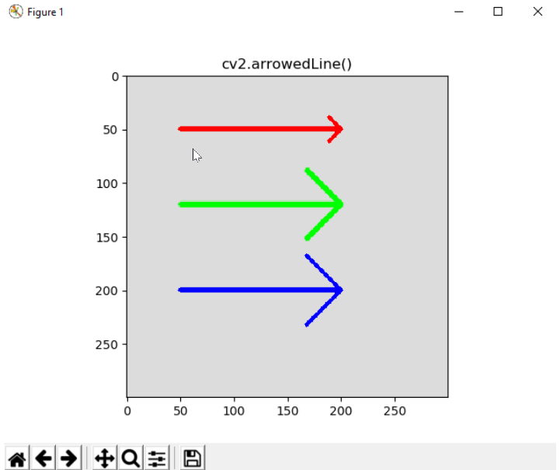
Drawing arrows
The signature for this function is as follows:
cv.arrowedLine(img, pt1, pt2, color, thickness=1, lineType=8, shift=0, tipLength=0.1)
This function allows you to create an arrow, which points from the first point defined by pt1 to the second point defined by pt2. The length of the arrow tip can be controlled by the tipLength parameter, which is defined in relation to the segment length (distance between pt1 and pt2):
cv2.arrowedLine(image, (50, 50), (200, 50), colors['red'], 3, 8, 0, 0.1)
cv2.arrowedLine(image, (50, 120), (200, 120), colors['green'], 3, cv2.LINE_AA, 0, 0.3)
cv2.arrowedLine(image, (50, 200), (200, 200), colors['blue'], 3, 8, 0, 0.3)
As you can see, three arrows are defined. See the next screenshot, where these arrows are plotted. Additionally, see the difference between cv2.LINE_AA (you can also write 16) and 8 (you can also write cv2.LINE_8):
In this example, we have combined (on purpose to call your attention) both enums (for example, cv2.LINE_AA) or writing the value directly (for example, 8) in connection with the lineType parameter. This is definitely not a good idea, because it could confuse you. One criterion should be established and maintained throughout all your code.

Slide 25
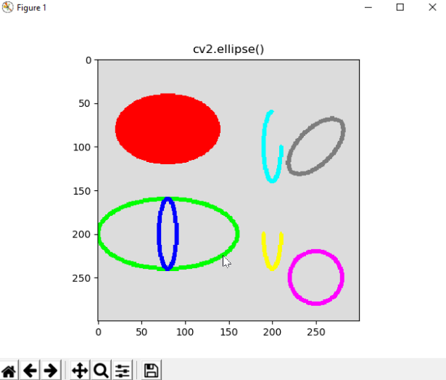
Drawing ellipses
The signature for this function is as follows:
cv2.ellipse(img, center, axes, angle, startAngle, endAngle, color, thickness=1, lineType=8, shift=0)
This function allows you to create different types of ellipses. The angle parameter (in degrees) allows you to rotate the ellipse. The axes parameter controls the size of the ellipse corresponding to half the size of the axes. If a full ellipse is required, startAngle = 0 and endAngle = 360. Otherwise, you should adjust these parameters to the required elliptic arc (in degrees). You can also see that, by passing the same value for the axes, you can draw a circle:
cv2.ellipse(image, (80, 80), (60, 40), 0, 0, 360, colors['red'], -1)
cv2.ellipse(image, (80, 200), (80, 40), 0, 0, 360, colors['green'], 3)
cv2.ellipse(image, (80, 200), (10, 40), 0, 0, 360, colors['blue'], 3)
cv2.ellipse(image, (200, 200), (10, 40), 0, 0, 180, colors['yellow'], 3)
cv2.ellipse(image, (200, 100), (10, 40), 0, 0, 270, colors['cyan'], 3)
cv2.ellipse(image, (250, 250), (30, 30), 0, 0, 360, colors['magenta'], 3)
cv2.ellipse(image, (250, 100), (20, 40), 45, 0, 360, colors['gray'], 3)
These ellipses can be seen in the next screenshot:

Slide 26
Drawing polygons
The signature for this function is as follows:
cv2.polylines(img, pts, isClosed, color, thickness=1, lineType=8, shift=0)
This function allows you to create polygonal curves. Here the key parameter is pts, where the array defining the polygonal curve should be provided. The shape of this parameter should be (number_vertex, 1, 2). So a common approach is to define it by using np.array to create the coordinates (of the np.int32 type) and, afterward, reshape it to match the aforementioned shape. For example, to create a triangle, the code will look like this:
# These points define a triangle
pts = np.array([[250, 5], [220, 80], [280, 80]], np.int32)
# Reshape to shape (number_vertex, 1, 2)
pts = pts.reshape((-1, 1, 2))
# Print the shapes: this line is not necessary, only for visualization
print("shape of pts '{}'".format(pts.shape))
# this gives: shape of pts '(3, 1, 2)'

Slide 27
Drawing polygons
Another important parameter is isClosed. If this parameter is True, the polygon will be drawn closed. Otherwise, a line segment between the first and last vertex will not be plotted, resulting in an open polygon. For a complete explanation, in order to draw a closed triangle, the code is given next:
# These points define a triangle
pts = np.array([[250, 5], [220, 80], [280, 80]], np.int32)
# Reshape to shape (number_vertex, 1, 2)
pts = pts.reshape((-1, 1, 2))
# Print the shapes: this line is not necessary, only for visualization
print("shape of pts '{}'".format(pts.shape))
# Draw this poligon with True option
cv2.polylines(image, [pts], True, colors['green'], 3)
In the same way, we have coded pentagons and rectangles, which can be seen in the next screenshot:

Slide 28
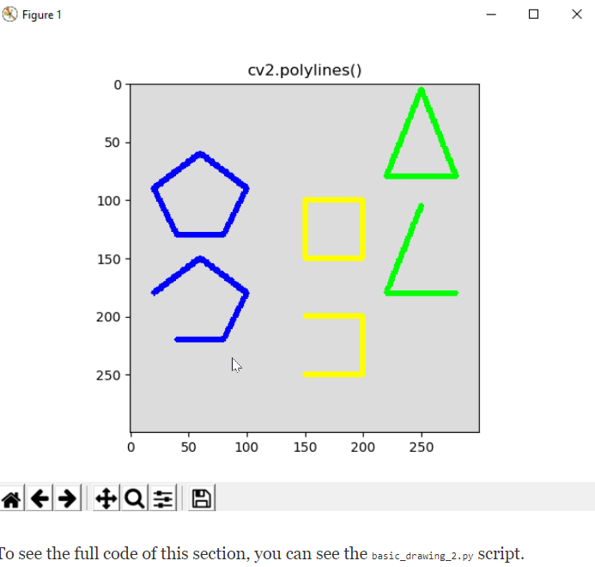
Drawing polygons

Slide 29

Shift parameter in drawing functions
Some of the previous functions (the ones with the shift parameter) can work with sub-pixel accuracy in connection with the pixel coordinates. To cope with this, you should pass the coordinates as fixed-point numbers, which are encoded as integers.
A fixed-point number means that there is a specific (fixed) number of digits (bits) reserved for both the integer (on the left of the decimal point) and the fractional parts (on the right of the decimal point).
Therefore, the shift parameter allows you to specify the number of the fractional bits (on the right of the decimal point). In the end, the real point coordinates are calculated as follows:

Slide 30

Shift parameter in drawing functions
For example, this piece of code draws two circles with a radius of 300. One of them uses a value of shift = 2 to provide sub-pixel accuracy. In this case, you should multiply both the origin and the radius by a factor of
shift = 2
factor = 2 ** shift
print("factor: '{}'".format(factor))
cv2.circle(image, (int(round(299.99 * factor)), int(round(299.99 * factor))), 300 * factor, colors['red'], 1, shift=shift)
cv2.circle(image, (299, 299), 300, colors['green'], 1)

Slide 31

Shift parameter in drawing functions
If shift = 3, the value for the factor will be 8 (2shift = 3), and so on. Multiplying by powers of 2 is the same as shifting the bits corresponding to the integer binary representations to the left by one. This way you can draw float coordinates. To summarize this point, we can also create a wrapper function for cv2.circle(), which can cope with float coordinates—draw_float_circle()—using the shift argument property. The key code for this example is shown next. The full code is defined in the shift_parameter.py script:

Slide 32
Shift parameter in drawing functions
def draw_float_circle(img, center, radius, color, thickness=1, lineType=8, shift=4):
"""Wrapper function to draw float-coordinate circles
"""
factor = 2 ** shift
center = (int(round(center[0] * factor)), int(round(center[1] * factor)))
radius = int(round(radius * factor))
cv2.circle(img, center, radius, color, thickness, lineType, shift)
draw_float_circle(image, (299, 299), 300, colors['red'], 1, 8, 0)
draw_float_circle(image, (299.9, 299.9), 300, colors['green'], 1, 8, 1)
draw_float_circle(image, (299.99, 299.99), 300, colors['blue'], 1, 8, 2)
draw_float_circle(image, (299.999, 299.999), 300, colors['yellow'], 1, 8, 3)

Slide 33
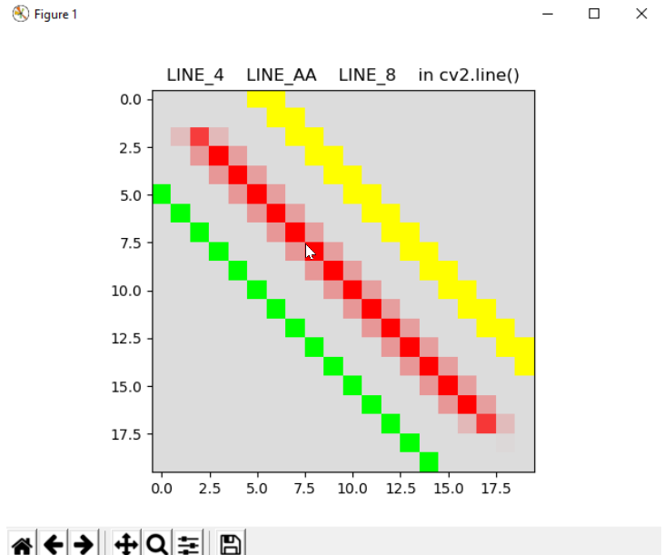
lineType parameter in drawing functions
Another common parameter is lineType, which can take three different values. We have previously commented on the differences between these three types. In order to see it more clearly, you can see the next screenshot, where we have plotted three lines with the same thickness and inclination: yellow = cv2.LINE_4, red = cv2.LINE_AA, and green = cv2.LINE_8. To see the full code of this example, you can check the basic_line_types.py script:

Slide 34
Writing text
OpenCV can also be used to render text in images. In this section, we will see how to draw text by using the cv2.putText() function. Additionally, we will see all the available fonts you can use. Lastly, we will see some OpenCV functions in connection with text drawing.

Slide 35
Drawing text
The cv2.putText() function has the following signature:
img = cv.putText( img, text, org, fontFace, fontScale, color, thickness=1, lineType= 8, bottomLeftOrigin=False)
This function draws the provided text string starting at the org coordinate (upper-left corner if bottomLeftOrigin = False and lower-left corner otherwise) using the font type provided by fontFace and the fontScale factor. In connection with this example, you can see that the last provided parameter, which is lineType, takes the three different values available in OpenCV (cv2.LINE_4, cv2.LINE_8, and cv2.LINE_AA). In this way, you can see the difference better when plotting these types. Remember that cv2.LINE_AA gives much better quality (an anti-aliased line type), but it is slower to draw than the other two types. The key code to draw some text is given next. The full code for this example can be seen in the text_drawing.py script:
# We draw some text on the image:
cv2.putText(image, OpenCV4 with Python', (10, 30), cv2.FONT_HERSHEY_SIMPLEX, 0.9, colors['red'], 2, cv2.LINE_4)
cv2.putText(image, OpenCV4 with Python', (10, 70), cv2.FONT_HERSHEY_SIMPLEX, 0.9, colors['red'], 2, cv2.LINE_8)
cv2.putText(image, OpenCV4 with Python', (10, 110), cv2.FONT_HERSHEY_SIMPLEX, 0.9, colors['red'], 2, cv2.LINE_AA)
# Show image:
show_with_matplotlib(image, 'cv2.putText()')
In the next screenshot, you can see the result:

Slide 36
Using all OpenCV text fonts
All the available fonts in OpenCV are as follows:
FONT_HERSHEY_SIMPLEX = 0
FONT_HERSHEY_PLAIN = 1
FONT_HERSHEY_DUPLEX = 2
FONT_HERSHEY_COMPLEX = 3
FONT_HERSHEY_TRIPLEX = 4
FONT_HERSHEY_COMPLEX_SMALL = 5
FONT_HERSHEY_SCRIPT_SIMPLEX = 6
FONT_HERSHEY_SCRIPT_COMPLEX = 7

Slide 37
Using all OpenCV text fonts
In connection with this, we have coded the text_drawing_fonts.py script, which plots all the available fonts. As all these fonts are in the (0-7) range, we can iterate and call the cv2.putText() function, varying the color, fontFace, and org parameters. We have also plotted lowercase and uppercase versions of these fonts. The key piece of code to perform this functionality is as follows:
position = (10, 30)
for i in range(0, 8):
cv2.putText(image, fonts[i], position, i, 1.1, colors[index_colors[i]], 2, cv2.LINE_4)
position = (position[0], position[1] + 40)
cv2.putText(image, fonts[i].lower(), position, i, 1.1, colors[index_colors[i]], 2, cv2.LINE_4)
position = (position[0], position[1] + 40)

Slide 38
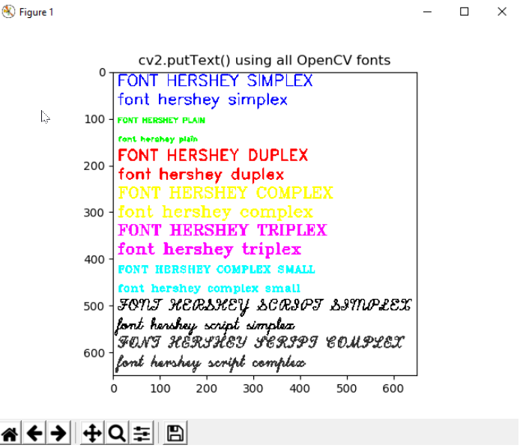
Using all OpenCV text fonts

Slide 39
More functions related to text
OpenCV provides more functions in connection with text drawing. It should be noted that these functions are not for drawing text, but they can be used to complement the aforementioned cv2.putText() function, and they are commented as follows. The first function we are going to see is cv2.getFontScaleFromHeight(). The signature for this function is as follows:
retval = cv2.getFontScaleFromHeight(fontFace, pixelHeight, thickness=1)
This function returns the font scale (fontScale), which is a parameter to use in the cv2.putText() function, to achieve the provided height (in pixels) and taking into account both the font type (fontFace) and thickness.
The second function is cv2.getTextSize():
retval, baseLine = cv2.getTextSize(text, fontFace, fontScale, thickness)

Slide 40
More functions related to text
This function can be used to get the text size (width and height) based on the following arguments—text to draw, the font type (fontFace), scale, and thickness. This function returns size and baseLine, which corresponds to the y coordinate of the baseline relative to the bottom of the text. The next piece of code shows you the key aspects to see this functionality. The full code is available in the text_drawing_bounding_box.py script:

Slide 41
More functions related to text
# assign parameters to use in the drawing functions
font = cv2.FONT_HERSHEY_SIMPLEX
font_scale = 2.5
thickness = 5
text = 'abcdefghijklmnopqrstuvwxyz'
circle_radius = 10
# We get the size of the text
ret, baseline = cv2.getTextSize(text, font, font_scale, thickness)
# We get the text width and text height from ret
text_width, text_height = ret
# We center the text in the image
text_x = int(round((image.shape[1] - text_width) / 2))
text_y = int(round((image.shape[0] + text_height) / 2))
# Draw this point for reference:
cv2.circle(image, (text_x, text_y), circle_radius, colors['green'], -1)
# Draw the rectangle (bounding box of the text)
cv2.rectangle(image, (text_x, text_y + baseline), (text_x + text_width - thickness, text_y - text_height),
colors['blue'], thickness)
# Draw the circles defining the rectangle
cv2.circle(image, (text_x, text_y + baseline), circle_radius, colors['red'], -1)
cv2.circle(image, (text_x + text_width - thickness, text_y - text_height), circle_radius, colors['cyan'], -1)
# Draw the baseline line
cv2.line(image, (text_x, text_y + int(round(thickness/2))), (text_x + text_width - thickness, text_y +
int(round(thickness/2))), colors['yellow'], thickness)
# Write the text centered in the image
cv2.putText(image, text, (text_x, text_y), font, font_scale, colors['magenta'], thickness)

Slide 42
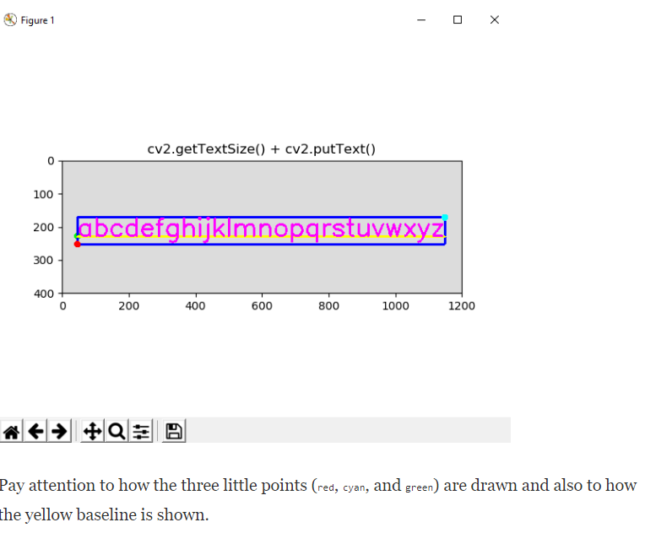
More functions related to text

Slide 43
Dynamic drawing with mouse events
In this section, you will learn how to perform dynamic drawing using mouse events. We are going to see some examples in increasing order of complexity.

Slide 44
Drawing dynamic shapes
The next example gives you an introduction into how to handle mouse events with OpenCV. The cv2.setMouseCallback() function performs this functionality. The signature for this method is as follows:
cv2.setMouseCallback(windowName, onMouse, param=None)
This function establishes the mouse handler for the window named windowName. The onMouse function is the callback function, which is called when a mouse event is performed (for example, double-click, left-button down, left-button up, among others). The optional param parameter is used to pass additional information to the callback function.

Slide 45
Drawing dynamic shapes
So the first step is to create the callback function:
# This is the mouse callback function:
def draw_circle(event, x, y, flags, param):
if event == cv2.EVENT_LBUTTONDBLCLK:
print("event: EVENT_LBUTTONDBLCLK")
cv2.circle(image, (x, y), 10, colors['magenta'], -1)
if event == cv2.EVENT_MOUSEMOVE:
print("event: EVENT_MOUSEMOVE")
if event == cv2.EVENT_LBUTTONUP:
print("event: EVENT_LBUTTONUP")
if event == cv2.EVENT_LBUTTONDOWN:
print("event: EVENT_LBUTTONDOWN")
The draw_circle() function receives the specific event and the coordinates (x, y) for every mouse event. In this case, when a left double-click (cv2.EVENT_LBUTTONDBLCLK) is performed, we draw a circle in the corresponding (x, y) coordinates on the event.
Additionally, we have also printed some messages in order to see other produced events, but we do not use them to perform any additional actions.

Slide 46
Drawing dynamic shapes
The next step is to create a named window. In this case, we named it Image mouse. This named window is where the mouse callback function will be associated with:
# We create a named window where the mouse callback will be established
cv2.namedWindow('Image mouse')
And finally, we set (or activate) the mouse callback function to the function we created before:
# We set the mouse callback function to 'draw_circle'
cv2.setMouseCallback('Image mouse', draw_circle)
In summary, when a left double-click is performed, a filled magenta circle is drawn centered at the (x, y) position of the performed double-click. The full code for this example can be seen in the mouse_drawing.py script.

Slide 47
Drawing both text and shapes
In this example, we are combining both mouse events and drawing text. In this sense, some text is rendered to show how to use the mouse events to perform specific actions. To better understand this example, in the next screenshot you can see the rendered text:

Slide 48
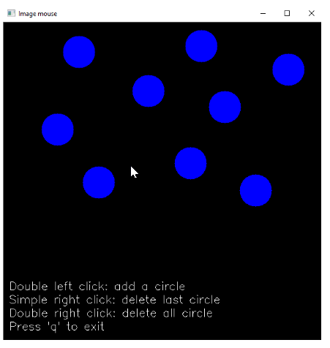
Drawing both text and shapes

Slide 49
Drawing both text and shapes
You can do the following:
Add a circle using the double left-click
Delete the last added circle using a simple left-click
Delete all circles using the double right-click
To perform this functionality, we create a list called circles, where we maintain the current circles selected by the user. Additionally, we also create a backup image with the rendered text. When a mouse event is produced, we add or delete the circles from the circles list. Afterward, when drawing, we draw only the current circles from the list. So, for example, when the user performs a simple right-click, the last added circle is deleted from the list. The full code is provided in the mouse_drawing_circles_and_text.py script.

Slide 50
Event handling with Matplotlib
You can see in the previous example that we have not used Matplotlib to show the image. This is because Matplotlib can also deal with event handling and picking. Therefore, you can use Matplotlib capabilities to capture mouse events. There are more events that we can connect with Matplotlib (https://matplotlib.org/users/event_handling.html). For example, in connection with the mouse, we can connect with the following events—button_press_event, button_release_event, motion_notify_event, and scroll_event.
We are going to show a simple example in order to render a circle when a mouse click is performed connecting with the button_press_event event:
# 'button_press_event' is a MouseEvent where a mouse botton is click (pressed)
# When this event happens the function 'click_mouse_event' is called:
figure.canvas.mpl_connect('button_press_event', click_mouse_event)

Slide 51
Event handling with Matplotlib
We have also to define the event listener for the button_press_event event:
# We define the event listener for the 'button_press_event':
def click_mouse_event(event):
# (event.xdata, event.ydata) contains the float coordinates of the mouse click event:
cv2.circle(image, (int(round(event.xdata)), int(round(event.ydata))), 30, colors['blue'], cv2.FILLED)
# Call 'update_image()' method to update the Figure:
update_img_with_matplotlib()
Therefore, when a mouse click is performed, a blue circle is shown. It should be noted that we have coded the update_img_with_matplotlib() function. In the previous examples, we have used show_with_matplotlib(). The show_with_matplotlib() function is used to display an image using Matplotlib, while update_img_with_matplotlib() is used to update an existing figure. The full code for this example can be seen in the matplotlib_mouse_events.py script.

Slide 52
Advanced drawing
In this section, we are going to see how to combine some of the aforementioned functions to draw basic shapes in OpenCV (for example, lines, circles, rectangles, and text, among others) to render a more advanced drawing. To put all these pieces together, we have built an analog clock to show you the current time (hour, minutes, and seconds). For this, two scripts are coded:
analog_clock_values.py
analog_clock_opencv.py

Slide 53
Advanced drawing
The analog_clock_opencv.py script draws an analog clock, using cv.line(), cv.circle(), cv.rectangle(), and cv2.putText(). In this script, we first draw the static drawing. In this sense, you can see that there are two arrays containing fixed coordinates:
hours_orig = np.array(
[(620, 320), (580, 470), (470, 580), (320, 620), (170, 580), (60, 470), (20, 320), (60, 170), (169, 61), (319, 20),
(469, 60), (579, 169)])
hours_dest = np.array(
[(600, 320), (563, 460), (460, 562), (320, 600), (180, 563), (78, 460), (40, 320), (77, 180), (179, 78), (319, 40),
(459, 77), (562, 179)])

Slide 54
Advanced drawing
These arrays are necessary to render the hour markings, as they define the origin and destiny of the lines for every hour of the clock. So, these markings are drawn as follows:
for i in range(0, 12):
cv2.line(image, array_to_tuple(hours_orig[i]), array_to_tuple(hours_dest[i]), colors['black'], 3)
Additionally, a big circle is drawn, corresponding to the shape of the analog clock:
cv2.circle(image, (320, 320), 310, colors['dark_gray'], 8)
Finally, we draw the rectangle containing the Mastering OpenCV 4 with Python text, which will be rendered inside the clock:
cv2.rectangle(image, (150, 175), (490, 270), colors['dark_gray'], -1)
cv2.putText(image, "Mastering OpenCV 4", (150, 200), 1, 2, colors['light_gray'], 1, cv2.LINE_AA)
cv2.putText(image, "with Python", (210, 250), 1, 2, colors['light_gray'], 1, cv2.LINE_AA)
Once this static information is drawn in the image, we copy it to the image_original image:
image_original = image.copy()

Slide 55
Advanced drawing
To draw the dynamic information, several steps are performed:
Get the hour, minute, and second from the current time:
# Get current date:
date_time_now = datetime.datetime.now()
# Get current time from the date:
time_now = date_time_now.time()
# Get current hour-minute-second from the time:
hour = math.fmod(time_now.hour, 12)
minute = time_now.minute
second = time_now.second
Transform these values (hour, minute, and second) to angles:
# Get the hour, minute and second angles:
second_angle = math.fmod(second * 6 + 270, 360)
minute_angle = math.fmod(minute * 6 + 270, 360)
hour_angle = math.fmod((hour*30) + (minute/2) + 270, 360)

Slide 56
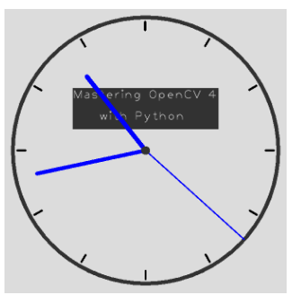
Advanced drawing
Draw the lines corresponding to the hour, minute, and second needles:
# Draw the lines corresponding to the hour, minute and second needles:
second_x = round(320 + 310 * math.cos(second_angle * 3.14 / 180))
second_y = round(320 + 310 * math.sin(second_angle * 3.14 / 180))
cv2.line(image, (320, 320), (second_x, second_y), colors['blue'], 2)
minute_x = round(320 + 260 * math.cos(minute_angle * 3.14 / 180))
minute_y = round(320 + 260 * math.sin(minute_angle * 3.14 / 180))
cv2.line(image, (320, 320), (minute_x, minute_y), colors['blue'], 8)
hour_x = round(320 + 220 * math.cos(hour_angle * 3.14 / 180))
hour_y = round(320 + 220 * math.sin(hour_angle * 3.14 / 180))
cv2.line(image, (320, 320), (hour_x, hour_y), colors['blue'], 10)
Finally, a small circle is drawn, corresponding to the point where the three needles join:
cv2.circle(image, (320, 320), 10, colors['dark_gray'], -1)

Slide 57
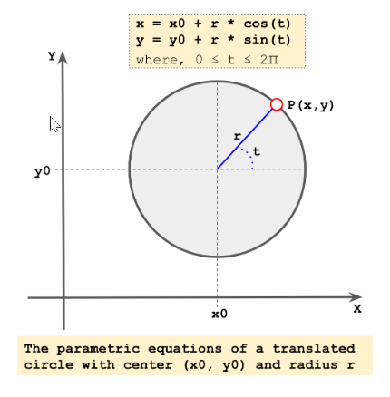
Advanced drawing
The script analog_clock_values.py script calculates the fixed coordinates for both the hours_orig and hours_dest arrays. To calculate the (x, y) coordinates for the hour markings, we use the parametric equation of a circle, as can be seen in the next screenshot:

Slide 58
Advanced drawing
We have followed the equation in the previous screenshot to calculate the coordinates for the 12 points P(x, y) at every 30 degrees and starting at 0 degrees (0, 30, 60, 90, 120, 150, 180, 210, 240, 270, 300, and 330) with two different radii. This way, we are able to define the coordinates for the lines defining the hour markings. The code to calculate these coordinates is as follows:
radius = 300
center = (320, 320)
for x in (0, 30, 60, 90, 120, 150, 180, 210, 240, 270, 300, 330):
x_coordinate = center[0] + radius * math.cos(x * 3.14/180)
y_coordinate = center[1] + radius * math.sin(x * 3.14/180)
print("x: {} y: {}".format(round(x_coordinate), round(y_coordinate)))
for x in (0, 30, 60, 90, 120, 150, 180, 210, 240, 270, 300, 330):
x_coordinate = center[0] + (radius - 20) * math.cos(x * 3.14/180)
y_coordinate = center[1] + (radius - 20) * math.sin(x * 3.14/180)
print("x: {} y: {}".format(round(x_coordinate), round(y_coordinate)))
The full code for this script can be seen in analog_clock_values.py. It should be noted that we could have included the code to calculate these coordinates inside the other script, but it can be a good exercise for you to do it.

